Slide 1
Creating data structures Dr Mariana Rocha School of Computer Science
CPMU 2007 Databases 1, Lecture 1

Slide 2

Before we start
Please scan the QR Code and provide your details (name, student number and email address).

Slide 3
Learning Objectives
Review the main concepts covered last week
Understand the syntax to create table
Understand the syntax to connect tables
Familiarise with the key constraints

Slide 4
What have we learned so far?
Relational Database
A collection of related records called rows (consisting of variables called columns), organized into tables
Tables are connected based on common variables
Records are related based on having common values for these common variables
Database Management System (DBMS)
System software that allows us to manage the content/information stored in a database

Slide 5
How do we instruct the DBMS?
SQL (Structured Query Language)
Includes:
Data Manipulation Language (DML)
Data Definition Language (DDL)
Before we can manipulate data, we need to
Define the data structure
Populate the data adhering to the constraints (outlined in the meta-data)

Slide 6
How do we instruct the DBMS?
SQL is case-insensitive – to the DBMS, CREATE or create means the same
However, there is a need to work on some convention in case other developers need to read your code
To practice that, we will write SQL keywords in uppercase letters, data type in uppercase letters, and table names and properties in lowercase letters.

Slide 7
DDL and DML main commands
DDL | Date | DML | Marks
Command | Definition | Command | Definition
CREATE TABLE | Defines a new table and its columns | INSERT INTO | Add new rows to existing table
ALTER TABLE | Modifies existing table structure (e.g. adding or removing columns) | UPDATE | Modifies rows in existing table
DROP TABLE | Deletes existing table and its data | DELETE FROM | Remove data from existing table
 |  | SELECT | Retrieves data from existing table(s)

Slide 8
Tables
Fundamental structure in the relational model
Organised collection of symbols
Organised into rows and columns
studentId | firstName | programme
S1 | Anne | C1
S2 | Boris | C1
S3 | Cindy | C3

Slide 9
Creating a table
A table is an object that can store data in a database.
You will create a table for each ‘thing’ you want to store data about.
When you create a table, you must specify:
the table name,
the name of each column,
the data type of each column,
the size of each column
any constraints on the data that each column can contain

Slide 10
Creating a table - process
Sometimes, we want to create a table that already exists
If you are sure you do not need a table with that name, use the DROP TABLE DDL statement before creating the new table
In Postgres, it is good practice to use DROP TABLE IF EXISTS. This statement will check if the table exists before trying to drop it.
It is good practice to drop tables in the opposite order they were created
Do not forget to comment on your code to make it clearer. Double dash (--) is used for single-line comments, while /* */is used to enclose multi-line comments.

Slide 11

Creating a table - example
Suppose we want to model a very basic version of IMDb (Internet Movie Database)

Slide 12
Creating a table - example
We want to store data about movies and actors
We need TWO basic tables: movies and actors
Let’s work on it together. Open DBeaver on your laptop or use the https://onecompiler.com/postgresql website to create the tables. Consider:
What commands will you use?
What columns will you include?
Which of these columns will be the unique identifier?
What types of data will you insert?

Slide 13
Creating a table - example
What piece of data is unique?
Movies
movieId, movieTitle, releaseYear, Director, Budget, Profit
Actors
actorId, actorName

Slide 14
Metadata - Datatypes in PostgreSQL
Data Type | SQL Code | Description
INTEGER | INTEGER or INT | A 32-bit signed integer.
BIGINT | BIGINT | A 64-bit signed integer.
CHAR(n) | CHAR(n) | Fixed-length character string with an exact length of ‘n’ characters.
VARCHAR(n) | VARCHAR(n) | Variable-length character string with a maximum length of 'n' characters.
TEXT | TEXT | Variable-length character string without a maximum length.
TIMESTAMP | TIMESTAMP | Date and time including fractional seconds.
DATE | DATE | Date without a time component.
BOOLEAN | BOOLEAN | Represents true or false values.
DECIMAL(p, s) | DECIMAL(p, s) or NUMERIC(p, s) | Fixed-point number with 'p' total digits and 's' fractional digits.

Slide 15
Creating a table - example
Movies
CREATE TABLE movies (movieId SERIAL PRIMARY KEY, movieTitle VARCHAR(50), releaseYear INT, director VARCHAR(30), budget INT, profit INT);
Actors
CREATE TABLE actors (actorId SERIAL PRIMARY KEY, actorName VARCHAR(30));

Slide 16
Naming tables
The table name
Call your table a name that is short and sensible.
Reflect the names in your design.
Table names and column names:
Must begin with a letter
Must be 1–30 characters long
Must contain characters between A–Z, a–z, 0–9, _, $, and # (no spaces of hyphens (-) or quotation marks)
Must not duplicate the name of another object owned by the same user
Must not be a PostgreSQL server reserved word

Slide 17
Key constraints – Primary Key
Column or a set of columns that uniquely identify a specific instance of the thing a table represents
Every entity in the data model must have a primary key whose values uniquely identify instances of the entity.
The primary key enforces entity integrity by uniquely identifying entity instances.

Slide 18
Key constraints – Primary Key
Entity
movies
Movie ID
Movie Title
Year
Director
Budget
Profit
actor
ActorID
Actor Name
Attribute

Slide 19
Key constraints – Primary Key
To qualify as a primary key, a column must have the following properties:
it must have a non-null value for each instance of the entity
the value must be unique for each instance of an entity
the values must not change or become null during the life of each entity instance
Can you think of a real-life example?

Slide 20
Key constraints – Primary Key
Let's assume that for each employee in an organisation, there are three candidate keys:
Employee ID, PPS Number, and Name.
Which one we should pick as the primary key?

Slide 21
Defining a primary key – Column level
The primary key can be defined at a column level, inserting the keywords PRIMARY KEY in line with the chosen column.
CREATE TABLE Actor(
actorID SERIAL PRIMARY KEY,
actorName VARCHAR(30)
);

Slide 22
Defining a primary key – table level
The primary key can also be defined at the table level, adding the information to the end of the SQL DDL query.
CREATE TABLE Actor(
actorID SERIAL,
actorName VARCHAR(30),
PRIMARY KEY (actorID)
);

Slide 23
Defining a primary key – naming PK
It is also possible to give a name to the primary key constraint. This action facilitates maintenance and allows informative error messages.
CREATE TABLE Actor(
actorID SERIAL,
actorName VARCHAR(30),
CONSTRAINT actors_pk PRIMARY KEY (actorID)
);

Slide 24
IMDb Example
We have now created data structures
Two basic tables
Each table represents one thing we want to store data about (Movie and Actor)
Each table has a set of columns which define the type of data we want to store about the thing the table represents
Each table has a primary key defined through which we can retrieve specific rows of data
However, we do not have a mechanism to store data about a movie cast, i.e. the actors who appeared in a movie

Slide 25

IMDb example
Title: Jumanji: Welcome to the Jungle
Year: 2017
Director: Jake Kasdan
Budget: 90 million
Profit: 962,077,546
Dwayne Johnson is part of the cast

Slide 26

IMDb example
What else has Dwayne Johnson appeared in?

Slide 27
IMDb Example – movieCast
Suppose we include the actorID and name of the character played on the Movies table
Our primary key is now incorrect
We would have multiple rows of data for each movie
One for every actor who appeared in the movie
We would be storing the movieId, movie title, year, director, budget and profit on each row
This is wasteful and, if we need to change something, we have to change it all

Slide 28
IMDb Example – movieCast
The resulting table is redundant.
movieID | movieTitle | releaseYear | director | budget | profit | actorID
1 | Jumanji | 2017 | Jake Kasdan | 125,000,000 | 801,000,000 | 001
1 | Jumanji | 2017 | Jake Kasdan | 125,000,000 | 801,000,000 | 002
1 | Jumanji | 2017 | Jake Kasdan | 125,000,000 | 801,000,000 | 003

Slide 29
IMDb example – movieCast
Possible solution: introduce the table Cast
It has the attributes movieId, actorId and role name
What should our primary key be?
CREATE TABLE cast(
movieID SERIAL,
actorID SERIAL,
rolePlayed VARCHAR(50)
);

Slide 30
Compound primary key
Suppose we decide that the combination of movieID and actorID is unique
We need a Compound Primary Key
Remember: Compound primary keys can only be created at the table level
CREATE TABLE movieCast(
movieID SERIAL,
actorID SERIAL,
rolePlayed VARCHAR(50),
PRIMARY KEY (movieID, actorID)
);

Slide 31
IMDb structure
Three tables:
movieCast has a common data element with movies (movieId)
movieCast has a common data element with actors (actorId)
We must ensure this is expressed in the metadata to protect our data’s integrity.
movies
actors
movieCast

Slide 32
Defining table relationships
Foreign keys define relationships between tables
A foreign key is a constraint that establishes a link between two tables by ensuring that the values in one table's column(s) match the values in another table's primary key column(s). That happens when a column of one table is the same as the primary key of another
So we need to include something in our CREATE statement for movieCast to indicate which attribute is the foreign key

Slide 33
Foreign Keys
We know that Cast has two foreign keys: actorID and movieID
Movie
Movie ID (PK)
Movie Title
Year
Director
Budget
Profit
MovieCast
Actor ID (PK)
Movie ID (PK)
Role Played
Actor
Actor ID (PK)
Actor Name

Slide 34
Defining foreign keys
To define a foreign key between two tables, we declare the foreign key at a table level (after declaring the columns) and state from which table we are retrieving the data.
FOREIGN KEY: Defines the column in the child table at the table-constraint level
REFERENCES: Identifies the table and column in the parent table
CREATE TABLE movieCast(
movieID SERIAL,
actorID SERIAL,
rolePlayed VARCHAR(50),
CONSTRAINT cast_actor_fk FOREIGN KEY (actorId) REFERENCES actors (actorID),
CONSTRAINT cast_movie_fk FOREIGN KEY (movieId) REFERENCES movies (movieID),
PRIMARY KEY (movieID, actorID));

Slide 35
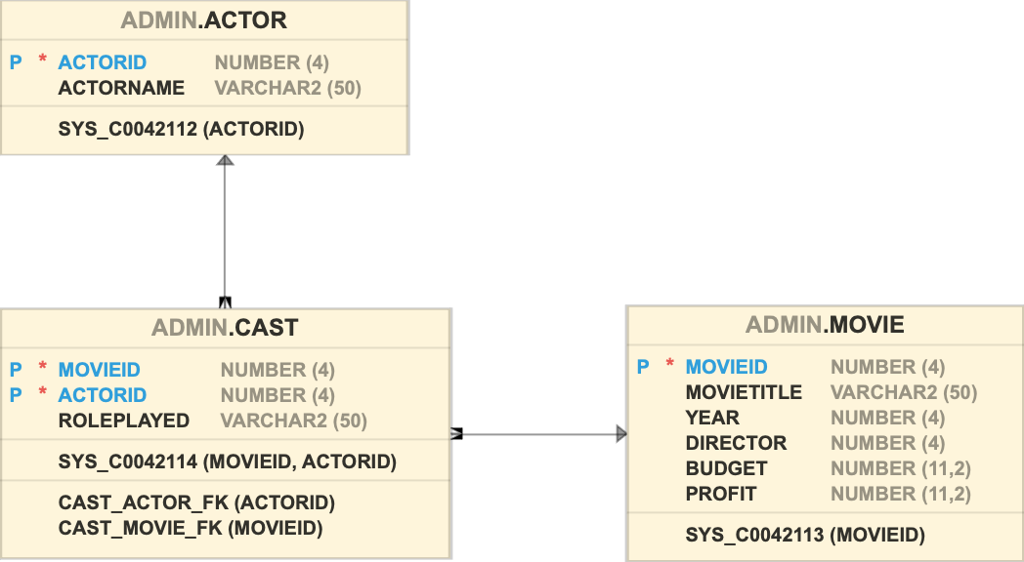
Defining tables relationships

Slide 36
Foreign keys
Foreign keys provide a method for maintaining integrity in the data (called referential integrity) and navigating between different instances of an entity.
Every relationship between tables must be supported by a foreign key.
Foreign key attributes are indicated by the notation (FK) beside them on database models.

Slide 37
The order of creation
We need to create the tables in order
Movie
Actor
Cast
Why?

Slide 38
The order of creation
First
Create tables that have no dependencies
Second
Create tables that depend on those tables but only have one dependency
Third
Create tables with multiple dependencies

Slide 39
DROP TABLE
All data and structure in the table are deleted.
Any pending TRANSACTION is committed.
All indexes are dropped.
All constraints are dropped.
Once the table is dropped, there is no turning back

Slide 40
DROP TABLE - order
The order used to drop the table also matters.
We should drop tables in the opposite order they were created
If we try to drop a table that contains a column that is a foreign key in another existing table, we get an error
First, delete tables with multiple dependencies, then tables with no dependencies

Slide 41
DROP TABLE - order
When we create a set of SQL in a script to create and insert data, we include statements to drop the tables at the start of that script
This will make sure our script clears out any old versions of our tables
If no tables exist, then we will get an error message
You can also use DROP TABLE IF EXISTS to skip that message

